Slide 1
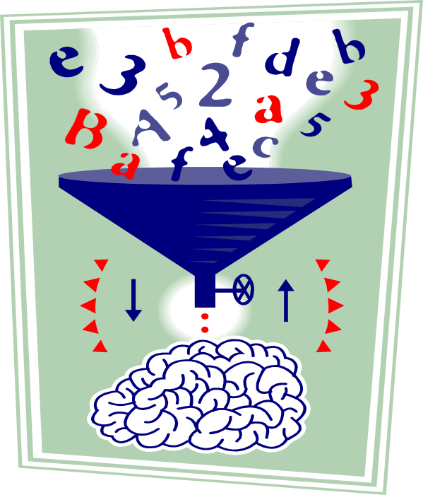
Data
Preparation for
Knowledge Discovery
Branko Kavšek
branko.kavsek@upr.si
Introduction to Machine Learning and Data Mining
Lecture #6

Slide 2
Outline: Data Preparation
Data Understanding
Data Cleaning
  Metadata
  Missing Values
  Unified Date Format
  Nominal to Numeric
  Discretization
Field Selection and “False Predictors”
Unbalanced Target Distribution
6th lecture
Intro to ML and DM
slide <number>/51

Slide 3
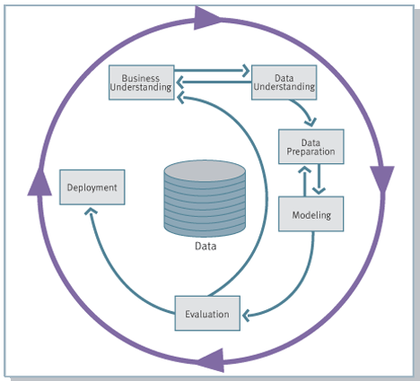
Knowledge Discovery Process flow, according to CRISP-DM
see
www.crisp-dm.org
for more
information
Monitoring
6th lecture
Intro to ML and DM
slide <number>/51

Slide 4
Knowledge Discovery Process, in practice
Data
Preparation
Monitoring
Data Preparation estimated to take 70-80% of the time and effort
6th lecture
Intro to ML and DM
slide <number>/51

Slide 5
Data Understanding: Relevance
What data is available for the task?
Is this data relevant?
Is additional relevant data available?
How much historical data is available?
Who is the data expert ?
6th lecture
Intro to ML and DM
slide <number>/51

Slide 6
Data Understanding: Quantity
Number of instances (records)
  Rule of thumb: 5,000 or more desired
  if less, results are less reliable; use special methods (boosting, …)
Number of attributes (fields)
  Rule of thumb: for each field, 10 or more instances
  If more fields, use feature reduction and selection
Number of targets
  Rule of thumb: >100 for each class
  if very unbalanced, use stratified sampling
6th lecture
Intro to ML and DM
slide <number>/51

Slide 7
Data Cleaning Steps
Data acquisition and metadata
Missing values
Unified date format
Converting nominal to numeric
Discretization of numeric data
Data validation and statistics
6th lecture
Intro to ML and DM
slide <number>/51

Slide 8
Data Cleaning: Acquisition
Data can be in DBMS
  ODBC, JDBC protocols
Data in a flat file
  Fixed-column format
  Delimited format: tab, comma “,” , other
  E.g. C4.5 and Weka “arff” use comma-delimited data
  Attention: Convert field delimiters inside strings
Verify the number of fields before and after
6th lecture
Intro to ML and DM
slide <number>/51

Slide 9
Data Cleaning: Example
Original data (fixed column format)
Clean data
000000000130.06.19971979-10-3080145722 #000310 111000301.01.000100000000004 0000000000000.000000000000000.000000000000000.000000000000000.000000000000000.000000000000000.000000000000000. 000000000000000.000000000000000.0000000...… 000000000000000.000000000000000.000000000000000.000000000000000.000000000000000.000000000000000.000000000000000.000000000000000.000000000000000.000000000000000.000000000000000.000000000000000.000000000000000.000000000000000.000000000000000.000000000000000.000000000000000.000000000000000.000000000000000.000000000000000.000000000000000.000000000000000.00 0000000000300.00 0000000000300.00
0000000001,199706,1979.833,8014,5722 , ,#000310 …. ,111,03,000101,0,04,0,0,0,0,0,0,0,0,0,0,0,0,0,0,0,0,0,0,0,0,0,0,0,0,0,0,0,0,0,0,0,0,0,0,0,0,0,0,0,0,0,0,0,0,0,0300,0,0,0,0,0,0,0,0,0,0,0,0,0,0,0,0,0,0,0,0,0,0,0,0,0,0,0,0,0,0,0,0,0,0,0,0,0,0,0,0,0,0,0,0,0,0,0,0300,0300.00
6th lecture
Intro to ML and DM
slide <number>/51

Slide 10
Data Cleaning: Metadata
Field types:
  binary, nominal (categorical), ordinal, numeric, …
  For nominal fields: tables translating codes to full descriptions
Field role:
  input : inputs for modeling
  target : output
  id/auxiliary : keep, but not use for modeling
  ignore : don’t use for modeling
  weight : instance weight
  …
Field descriptions
6th lecture
Intro to ML and DM
slide <number>/51

Slide 11
Data Cleaning: Reformatting
Convert data to a standard format
(e.g. arff or csv)
Missing values
Unified date format
Binning of numeric data
Fix errors and outliers
Convert nominal fields whose values have order to numeric.
  Q: Why?
6th lecture
Intro to ML and DM
slide <number>/51

Slide 12
Data Cleaning: Reformatting, 2
Convert nominal fields whose values have order to numeric to be able to use “>” and “<“ comparisons on these fields.
6th lecture
Intro to ML and DM
slide <number>/51

Slide 13
Data Cleaning: Missing Values
Missing data can appear in several forms:
  <empty field> “0” “.” “999” “NA” …
Standardize missing value code(s)
Q: How can we deal with missing values?
6th lecture
Intro to ML and DM
slide <number>/51

Slide 14
Data Cleaning: Missing Values, 2
Dealing with missing values:
  ignore records with missing values
  treat missing value as a separate value
  Imputation:
  fill in with mean or median values
  let the DM algorithm deal with it
6th lecture
Intro to ML and DM
slide <number>/51

Slide 15
Data Cleaning: Unified Date Format
We want to transform all dates to the same format internally
Some systems accept dates in many formats
  e.g. “Sep 24, 2003” , 9/24/03, 24.09.03, etc
  dates are transformed internally to a standard value
Frequently, just the year (YYYY) is sufficient
For more details, we may need the month, the day, the hour, etc
Representing date as YYYYMM or YYYYMMDD can be OK, but has problems
Q: What are the problems with YYYYMMDD dates?
6th lecture
Intro to ML and DM
slide <number>/51
Notes:
The problem with YYYYMM date format is that if we treat it as a number, it does not preserve intervals.
For example, the difference 200301 – 200212 is not the same as 200212 – 200211. This might be important when we model attrition or other events that require looking back in time.

Slide 16
Data Cleaning:
Unified Date Format, 2
Problems with YYYYMMDD dates:
  YYYYMMDD does not preserve intervals:
  20040201 – 20040131
  !=
  20040131 – 20040130
  This can introduce bias into models
6th lecture
Intro to ML and DM
slide <number>/51
Notes:
The problem with YYYYMM date format is that if we treat it as a number, it does not preserve intervals.
For example, the difference 200301 – 200212 is not the same as 200212 – 200211. This might be important when we model attrition or other events that require looking back in time.

Slide 17
Unified Date Format Options
To preserve intervals, we can use
  Unix system date:
  Number of seconds since 1970
  Number of days since Jan 1, 1960 (SAS)
Problem:
  values are non-obvious
  don’t help intuition and knowledge discovery
  harder to verify, easier to make an error
6th lecture
Intro to ML and DM
slide <number>/51

Slide 18
KSP Date Format
days_starting_Jan_1 - 0.5
  KSP Date = YYYY + --------------------------------------
  365 + 1_if_leap_year
Preserves intervals (almost)
The year and quarter are obvious
  Sep 24, 2003 is 2003 + (267-0.5)/365= 2003.7301 (round to 4 digits)
Consistent with date starting at noon
Can be extended to include time
6th lecture
Intro to ML and DM
slide <number>/51

Slide 19
Y2K issues: 2 digit Year
2-digit year in old data – legacy of Y2K
E.g. Q: Year 02 – is it 1902 or 2002 ?
  A: Depends on context (e.g. child birthday or year of house construction)
  Typical approach: CUTOFF year, e.g. 30
  if YY < CUTOFF , then 20YY, else 19YY
6th lecture
Intro to ML and DM
slide <number>/51

Slide 20
Conversion: Nominal to Numeric
Some tools can deal with nominal values internally
Other methods (neural nets, regression, nearest neighbor) require only numeric inputs
To use nominal fields in such methods need to convert them to a numeric value
  Q: Why not ignore nominal fields altogether?
  A: They may contain valuable information
Different strategies for binary, ordered,
multi-valued nominal fields
6th lecture
Intro to ML and DM
slide <number>/51
Notes:
A: Nominal fields convey important information

Slide 21
Conversion
How would you convert binary fields to numeric?
  E.g. Gender=M, F
How would you convert ordered attributes to numeric?
  E.g. Grades
6th lecture
Intro to ML and DM
slide <number>/51

Slide 22
Conversion: Binary to Numeric
Binary fields
  E.g. Gender=M, F
Convert to Field_0_1 with 0, 1 values
  e.g. Gender = M → Gender_0_1 = 0
  Gender = F → Gender_0_1 = 1
6th lecture
Intro to ML and DM
slide <number>/51

Slide 23
Conversion: Ordered to Numeric
Ordered attributes (e.g. Grade) can be converted to numbers preserving natural order, e.g.
  A → 4.0
  A- → 3.7
  B+ → 3.3
  B → 3.0
Q: Why is it important to preserve
natural order?
6th lecture
Intro to ML and DM
slide <number>/51
Notes:
A: to allow range comparisons, e.g. if Year >= junior

Slide 24
Conversion: Ordered to Numeric, 2
Natural order allows meaningful comparisons, e.g. Grade > 3.5
6th lecture
Intro to ML and DM
slide <number>/51
Notes:
A: to allow range comparisons, e.g. if Year >= junior

Slide 25
Conversion: Nominal, Few Values
Multi-valued, unordered attributes with small (rule of thumb < 20) no. of values
  e.g. Color=Red, Orange, Yellow, …, Violet
  for each value v create a binary “flag” variable C_v, which is 1 if Color=v, 0 otherwise
ID | Color | …
371 | red
433 | yellow
ID | C_red | C_orange | C_yellow | …
371 | 1 | 0 | 0
433 | 0 | 0 | 1
6th lecture
Intro to ML and DM
slide <number>/51

Slide 26
Conversion: Nominal, Many Values
Examples:
  US State Code (50 values)
  Profession Code (7,000 values, but only few frequent)
Q: How to deal with such fields?
A: Ignore ID-like fields whose values are unique for each record
For other fields, group values “naturally”:
  e.g. 50 US States → 3 or 5 regions
  Profession – select most frequent ones, group the rest
Create binary flag-fields for selected values
6th lecture
Intro to ML and DM
slide <number>/51

Slide 27
Data Cleaning: Discretization
Some methods require discrete values,
e.g. most versions of Naïve Bayes, …
Discretization is very useful for generating a summary of data
Also called “binning”
6th lecture
Intro to ML and DM
slide <number>/51

Slide 28
Discretization: Equal-width
Temperature values:
64 65 68 69 70 71 72 72 75 75 80 81 83 85
Count
4
2
2
2
0
2
2
[64,67) [67,70) [70,73) [73,76) [76,79) [79,82) [82,85]
  Equal Width, bins Low <= value < High
6th lecture
Intro to ML and DM
slide <number>/51

Slide 29
Discretization:
Equal-width may produce clumping
Count
1
[0 – 200,000) … ….
[1,800,000 –
2,000,000]
Salary in a corporation
6th lecture
Intro to ML and DM
slide <number>/51

Slide 30
Equal-width problems
Count
1
[0 – 200,000) … ….
[1,800,000 –
2,000,000]
Salary in a corporation
What can we do to get a more even distribution?
6th lecture
Intro to ML and DM
slide <number>/51

Slide 31
Discretization: Equal-height
Temperature values:
64 65 68 69 70 71 72 72 75 75 80 81 83 85
Count
4
4
4
2
[64 .. .. .. .. 69] [70 .. 72] [73 .. .. .. .. .. .. .. .. 81] [83 .. 85]
  Equal Height = 4, except for the last bin
6th lecture
Intro to ML and DM
slide <number>/51

Slide 32
Discretization: Equal-height advantages
Generally preferred because avoids clumping
In practice, “almost-equal” height binning is used which avoids clumping and gives more intuitive breakpoints
Additional considerations:
  don’t split frequent values across bins
  create separate bins for special values (e.g. 0)
  readable breakpoints (e.g. round breakpoints)
6th lecture
Intro to ML and DM
slide <number>/51

Slide 33
Discretization
How else can we discretize?
What is another method from the literature?
6th lecture
Intro to ML and DM
slide <number>/51

Slide 34
Discretization: Class Dependent
min of 3 values per bucket
64 65 68 69 70 71 72 72 75 75 80 81 83 85
Yes No Yes Yes Yes No No Yes Yes Yes No Yes Yes No
64
85
6th lecture
Intro to ML and DM
slide <number>/51

Slide 35
Discretization considerations
Equal Width is simplest, good for many classes
  can fail miserably for unequal distributions
Equal Height gives better results
Class-dependent can be better for classification
  Note: decision trees build discretization on the fly
  Naïve Bayes requires initial discretization
Many other methods exist …
6th lecture
Intro to ML and DM
slide <number>/51

Slide 36
Outliers and Errors
Outliers are values thought to be out of range.
Approaches:
  do nothing
  enforce upper and lower bounds
  let binning handle the problem
6th lecture
Intro to ML and DM
slide <number>/51

Slide 37
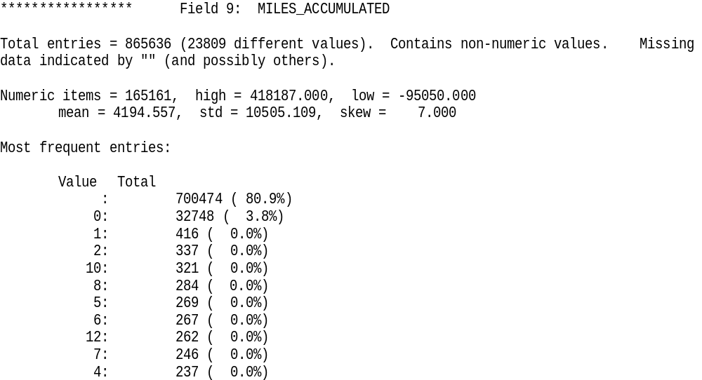
Examine Data Statistics
6th lecture
Intro to ML and DM
slide <number>/51

Slide 38
Data Cleaning: Field Selection
First: Remove fields with no or little variability
Examine the number of distinct field values
  Rule of thumb: remove a field where almost all values are the same (e.g. null), except possibly in minp % or less of all records.
  minp could be 0.5% or more generally less than 5% of the number of targets of the smallest class
6th lecture
Intro to ML and DM
slide <number>/51

Slide 39
False Predictors or Information “Leakers”
False predictors are fields correlated to target behavior, which describe events that happen at the same time or after the target behavior
If databases don’t have the event dates, a false predictor will appear as a good predictor
Example: Service cancellation date is a leaker when predicting attriters.
Q: Give another example of a false predictor
6th lecture
Intro to ML and DM
slide <number>/51
Notes:
SOURCE field in ALL/AML data

Slide 40
False Predictor Example
Q: What is a false predictor for a student’s likelihood of passing a course?
A: The student’s final grade.
6th lecture
Intro to ML and DM
slide <number>/51
Notes:
SOURCE field in ALL/AML data

Slide 41
False Predictors: Find “suspects”
Build an initial decision-tree model
Consider very strongly predictive fields as “suspects”
  strongly predictive – if a field by itself provides close to 100% accuracy, at the top or a branch below
Verify “suspects” using domain knowledge or with a domain expert
Remove false predictors and build an initial model
6th lecture
Intro to ML and DM
slide <number>/51

Slide 42
(Almost) Automated False Predictor Detection
For each field
  Build 1-field decision trees for each field
  (or compute correlation with the target field)
Rank all suspects by 1-field prediction accuracy (or correlation)
Remove suspects whose accuracy is close to 100% (Note: the threshold is domain dependent)
Verify top “suspects” with domain expert
6th lecture
Intro to ML and DM
slide <number>/51

Slide 43
Selecting Most Relevant Fields
If there are too many fields, select a subset that is most relevant.
Can select top N fields using 1-field predictive accuracy as computed earlier.
What is good N?
  Rule of thumb -- keep top 50 fields
6th lecture
Intro to ML and DM
slide <number>/51

Slide 44
Field Reduction Improves Classification
most learning algorithms look for non-linear combinations of fields -- can easily find many spurious combinations given small # of records and large # of fields
Classification accuracy improves if we first reduce number of fields
Multi-class heuristic: select equal # of fields from each class
6th lecture
Intro to ML and DM
slide <number>/51

Slide 45
Derived Variables
Better to have a fair modeling method and good variables, than to have the best modeling method and poor variables.
Insurance Example: People are eligible for pension withdrawal at age 59 ½.
Create it as a separate Boolean variable!
*Advanced methods exists for automatically examining variable combinations, but it is very computationally expensive!
6th lecture
Intro to ML and DM
slide <number>/51

Slide 46
Unbalanced Target Distribution
Sometimes, classes have very unequal frequency
  Attrition prediction: 97% stay, 3% attrite (in a month)
  medical diagnosis: 90% healthy, 10% disease
  eCommerce: 99% don’t buy, 1% buy
  Security: >99.99% of Americans are not terrorists
Similar situation with multiple classes
Majority class classifier can be 97% correct,
but useless
6th lecture
Intro to ML and DM
slide <number>/51

Slide 47
Handling Unbalanced Data
With two classes: let positive targets be a minority
Separate raw held-aside set (e.g. 30% of data) and raw train
  put aside raw held-aside and don’t use it till the final model
Select remaining positive targets (e.g. 70% of all targets) from raw train
Join with equal number of negative targets from raw train, and randomly sort it.
Separate randomized balanced set into balanced train and balanced test
6th lecture
Intro to ML and DM
slide <number>/51

Slide 48
Building Balanced Train Sets
Targets
Balanced set
Y
..
..
N
N
N
..
..
..
..
Y
..
N
..
Non-Targets
Raw Held
Balanced Train
Balanced Test
6th lecture
Intro to ML and DM
slide <number>/51

Slide 49
Learning with Unbalanced Data
Build models on balanced train/test sets
Estimate the final results (lift curve) on the raw held set
Can generalize “balancing” to multiple classes
  stratified sampling
  Ensure that each class is represented with approximately equal proportions in train and test
6th lecture
Intro to ML and DM
slide <number>/51

Slide 50
Data Preparation Key Ideas
Use meta-data
Inspect data for anomalies and errors
Eliminate “false predictors”
Optionally:
  reduce the number of fields
  “balance” the data
Plan for verification – verify the results
after each step
6th lecture
Intro to ML and DM
slide <number>/51

Slide 51
Summary
Good data preparation is key to producing valid and reliable models
6th lecture
Intro to ML and DM
slide <number>/51

